Slide 1


SNAP PARTICIPATION & MACHINE LEARNING
GROUP 2
Shareen, Le, Richard and Mauricio

Slide 2
Slide 10
The scope is SNAP participation surveys in 2012 and 2013
The source is the U.S. Department of Agriculture via FoodAPS National Household Food Acquisition and Purchase Survey (link)
The requirements for a data visualization project were:
At least 100 records
A cleaned database to house the data
Visual deliverables
Usability
This project resulted in
4826 records retrieved
SQL database and csv file
Unique visualizations
Executive Summary
10

Slide 3
Slide 10
DATASETS
FoodAPS National Household Food Acquisition and Purchase Survey
Five different datasets were retrieved:
faps_access_puf.csv
faps_fafhevent_puf.csv
faps_fahevent_puf.csv
faps_household_puf.csv
faps_meals_puf.csv
They includes nationally representative data from 4,826 households, including Supplemental Nutrition Assistance Program (SNAP) households, low-income households not participating in SNAP, and higher income households
10

Slide 4
Order of Operations & Outputs
Retrieve SNAP data from U.S. Department of Agriculture website
Data Cleaning
Machine Learning Modeling
Exploratory Data Analysis
SQL database
.csv
Histograms
Correlation matrix
Correlation heatmap
Boxplot
Pair plot
Logistic Regression
Random Forest
Neural network

Slide 5
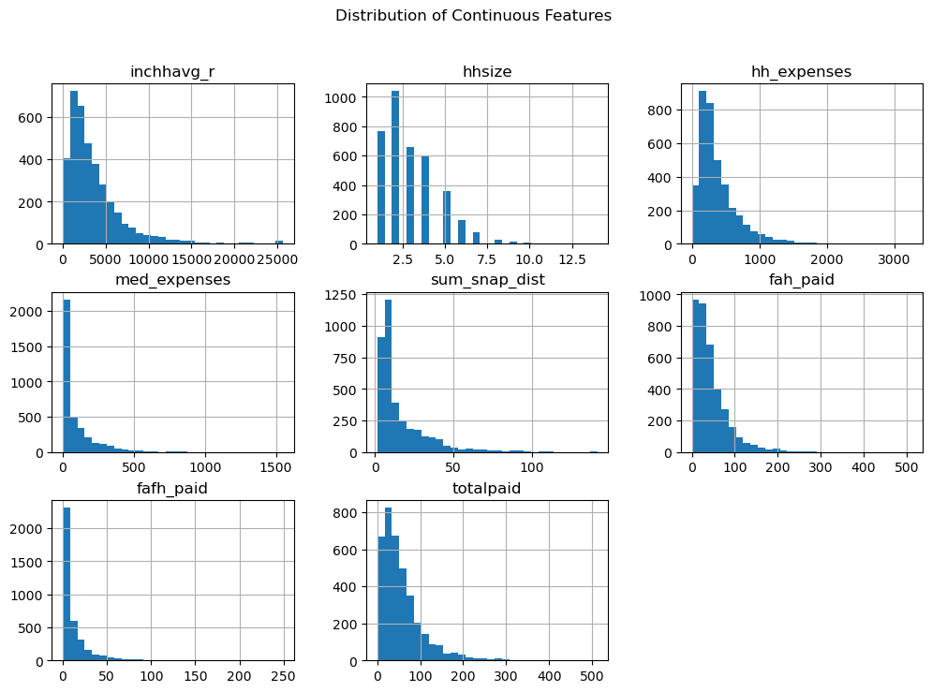
EXPLORATORY DATA ANALYSIS [EDA]
Plot histograms for continuous variables

Slide 6
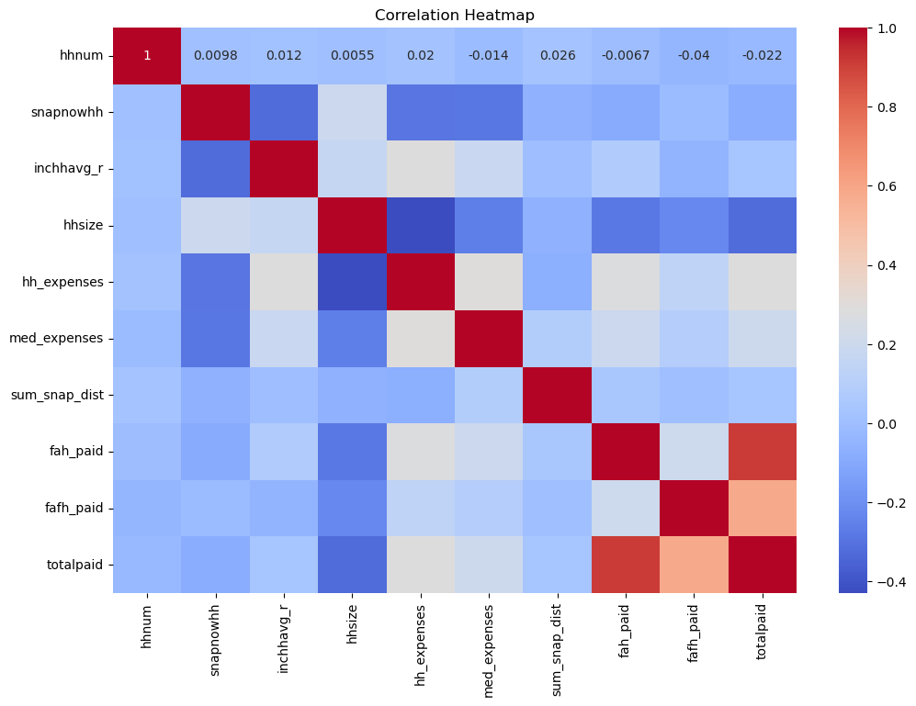
EXPLORATORY DATA ANALYSIS [EDA]
Plot correlation heatmap

Slide 7
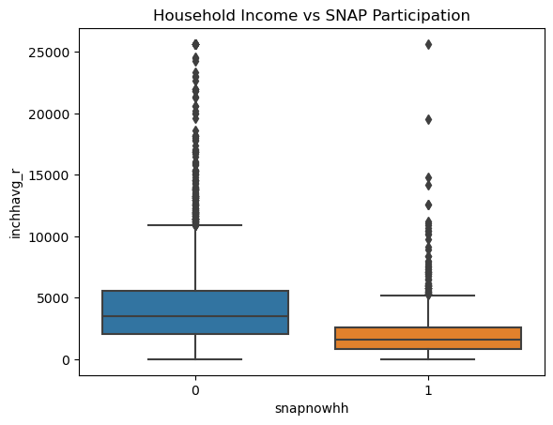
EXPLORATORY DATA ANALYSIS [EDA]
Boxplot for household income vs. SNAP participation

Slide 8
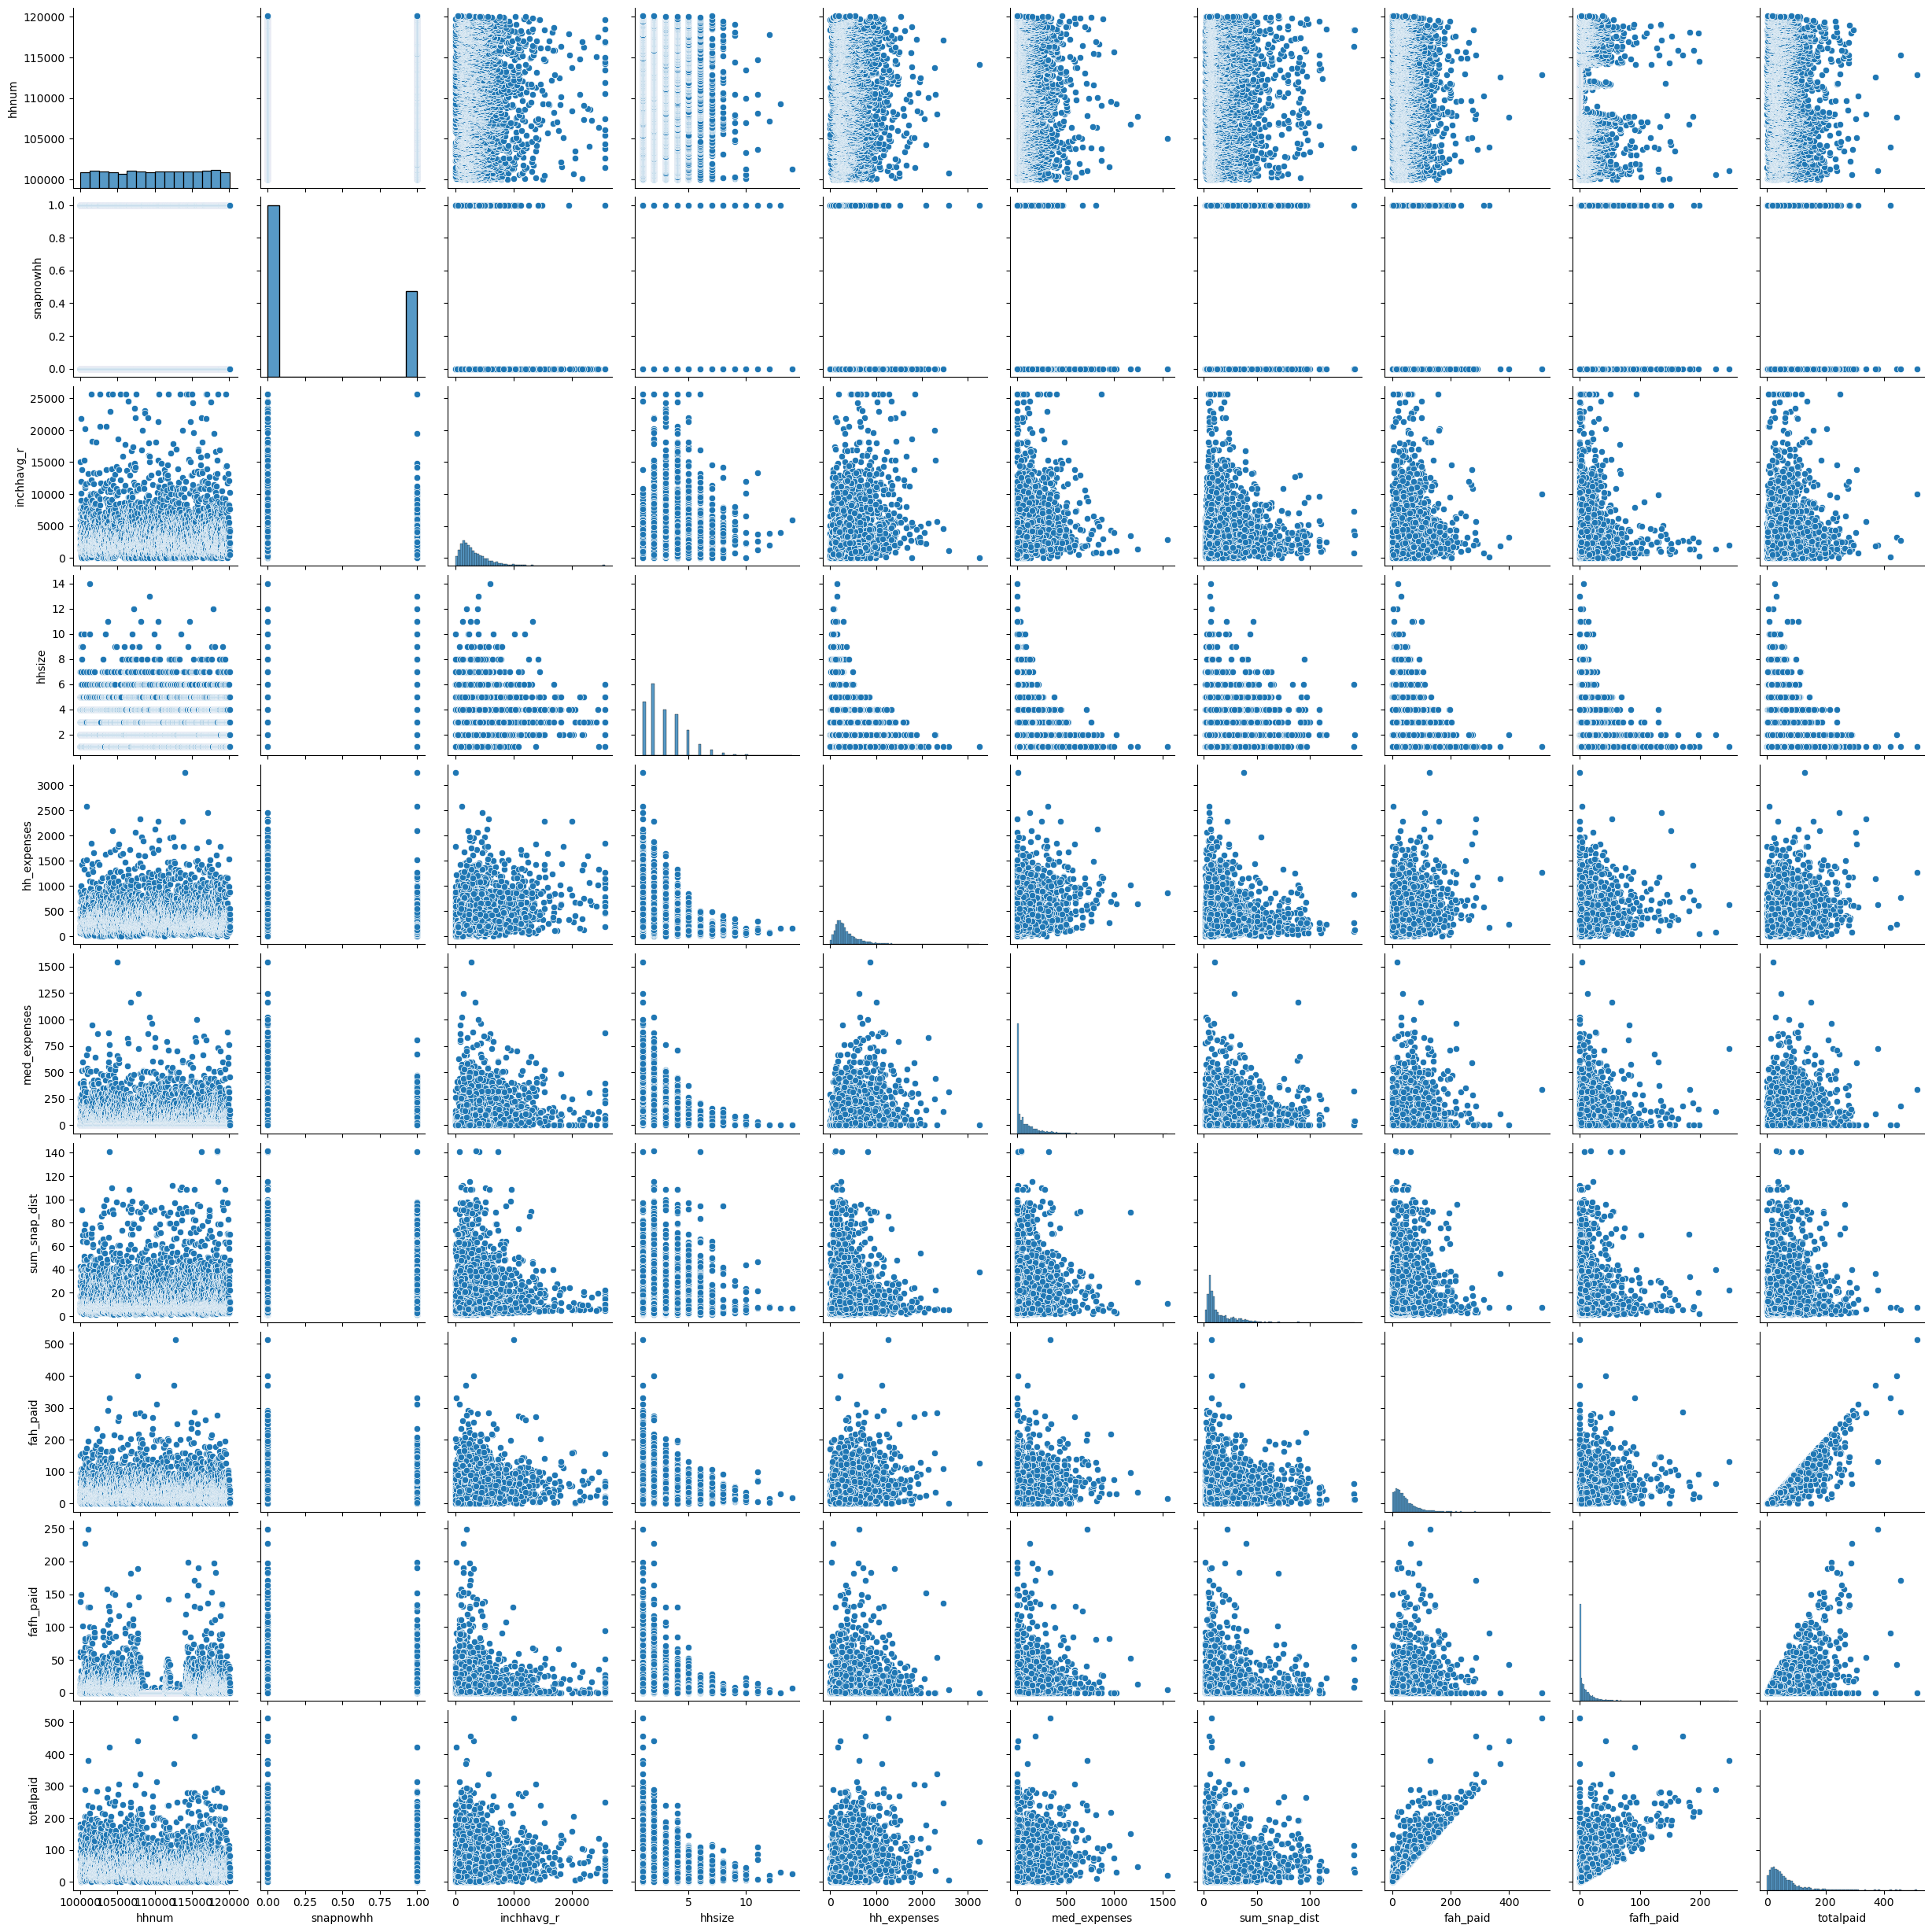
EXPLORATORY DATA ANALYSIS [EDA]
Pair plot

Slide 10
MACHINE LEARNING MODELINGS:
Logistic Regression
Random Forest Analysis
Neutral Network Testing

Slide 11
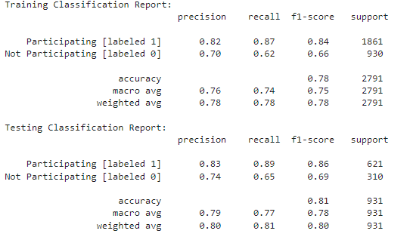
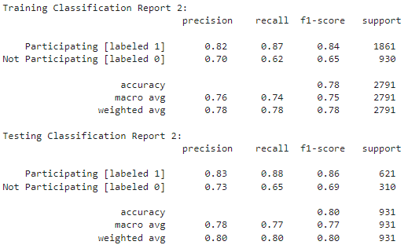
Logistic Regression
First Iteration
Second Iteration
(after removal of two features)

Slide 12
Logistic Regression
First Iteration
Second Iteration
(after removal of two features)
The model predicts with an average accuracy of 78%

Slide 13
Logistic Regression
First Iteration
Second Iteration
(after removal of two features)
The model predicts with an average accuracy of 78%
The model struggles to accurately predict "Not Participating" instances

Slide 14
Logistic Regression
First Iteration
Second Iteration
(after removal of two features)
The model predicts with an average accuracy of 78%
The model struggles to accurately predict "Not Participating" instances
CONCLUSION: No improvement to model accuracy by removing features, namely fah_paid and fafh_paid

Slide 15
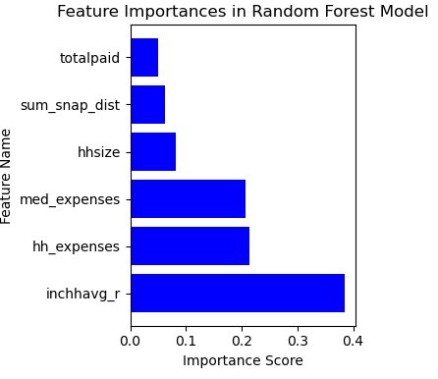
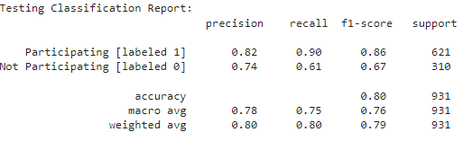
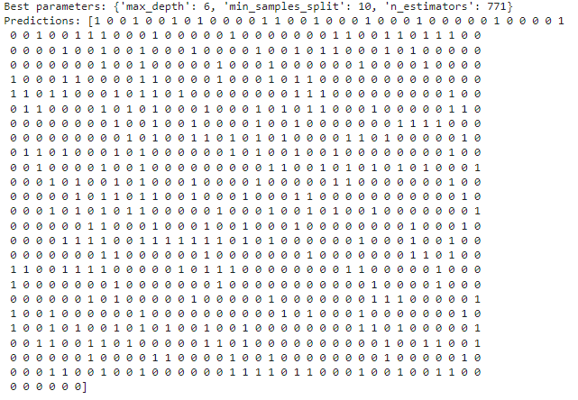
Random Forest
Classification Report
Feature Importance
Best parameters and predictions:

Slide 16
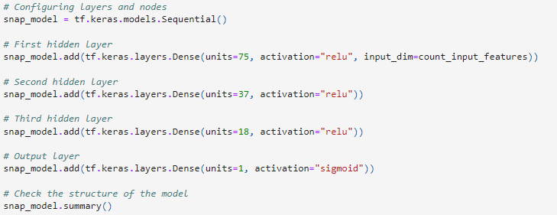
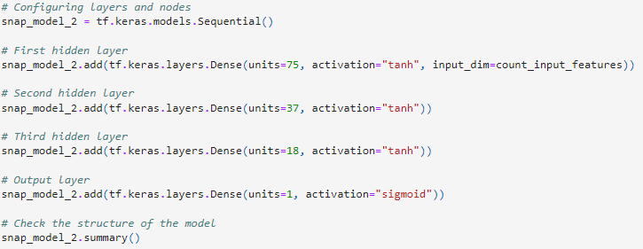
Neural Network
First Iteration w/ relu
Second Iteration with tanh
0.782
0.802
CONCLUSION: Changing to activation function to tanh may be advantageous because tanh is centered around 0 [-1 to 1], whereas relu is less centered [0 to infinity]. This may be because our y feature is binary in nature (1 = yes, 0 = no).

Slide 17
Tableau for the SNAP Participation and Machine Learning Project
Bar and line charts to visualize Count of household, avg. of Snap distance and avg. of income vs household size
Scatter plot of the distribution of FAFH Paid and FAH Paid
Gantt charts to visualize Avg. Income vs. Expenses
**Add link to Tableau public**

Slide 18
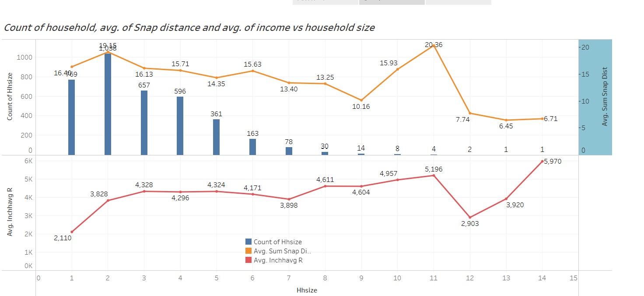
Bar and line charts to visualize Count of household, avg. of Snap distance and avg. of income vs household size

Slide 19
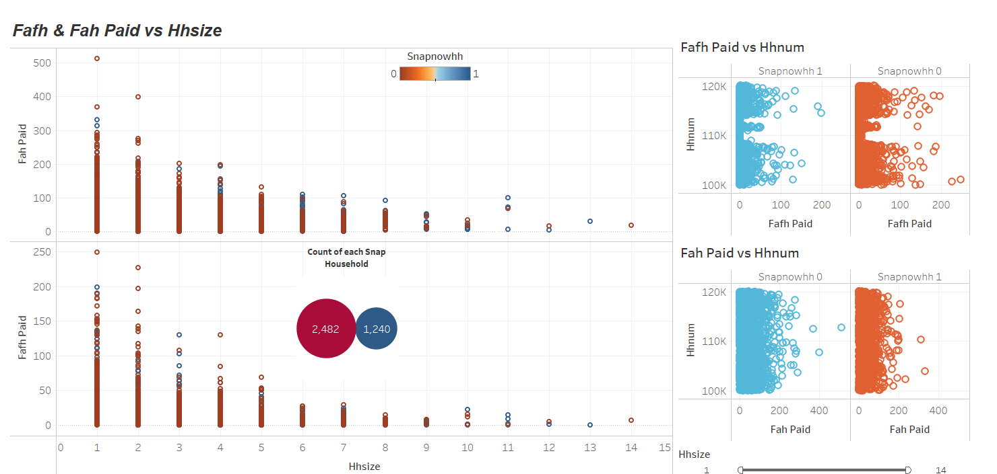
Scatter plot of the distribution of FAFH Paid and FAH Paid

Slide 20
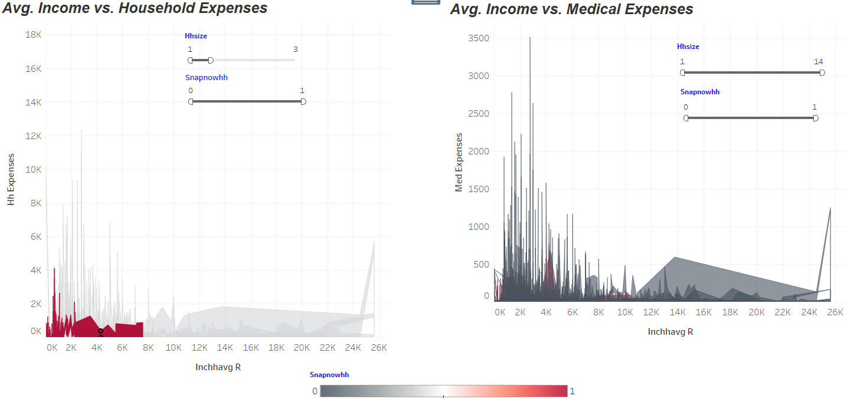
Gantt charts to visualize Avg. Income vs. Expenses

Slide 21
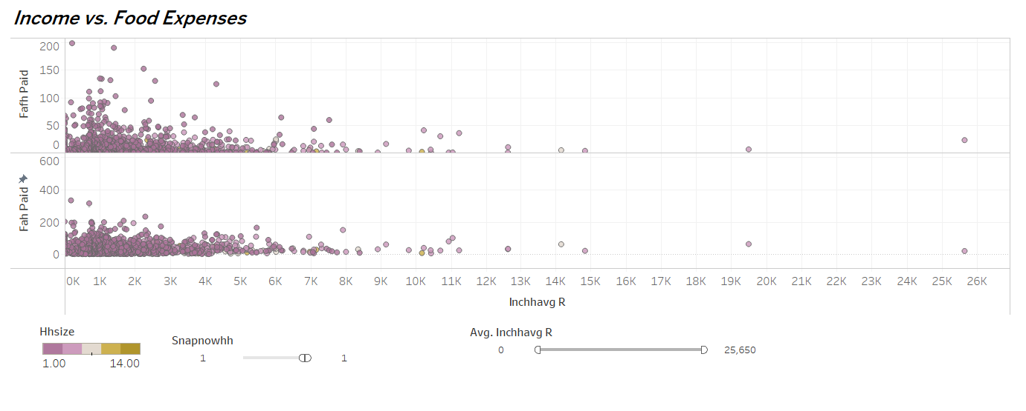
Gantt charts to visualize Avg. Income vs. Expenses

